Slide 1
SGD and LosS Functions

Slide 2
Gradient Descent

Slide 3
Batch Gradient Descent (BGD)
Involves calculations over the full training set X, at each Gradient Descent step
Slow on very large training sets
Scales well with the number of features
Learning Rate

Slide 4
Stochastic Gradient Descent (SGD)
SGD picks a random instance in the training set at every step and computes the gradients based only on that single instance
Convergence is much more irregular than BGD
When cost function is very irregular, SGD can help the algorithm jump out of local minima

Slide 5
Mini-Batch Gradient Descent (MBGD)
MBGD computes the gradients on small random sets of instances called mini-batches

Slide 6
Regression Loss Function
MSE/Quadratic/L2 Loss
Mean Absolute Error (MAE) /L1 Loss
Mean Bias Error

Slide 7
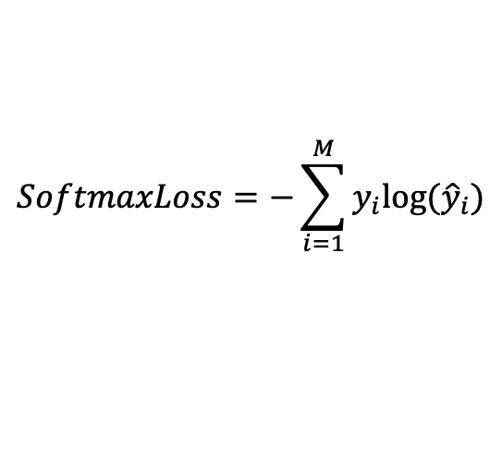
Classification Loss Functions
Hinge Loss
the score of correct category should be greater than sum of scores of all incorrect categories by some safety margin (usually one)
Cross Entropy/(Multinomial) Log(istic)/ Loss/Negative Log Likelihood
Most common setting for classification problems.
Cross-entropy loss increases as the predicted probability diverges from the actual label.
Categorical Cross-Entropy/Softmax Loss
$$SoftmaxLoss=−\sum_{i=1}^{M}{y_{i}log⁡({\hat{y}}_{i})}$$

Slide 8
Further Reading
https://ml-cheatsheet.readthedocs.io/en/latest/loss_functions.html#
https://www.analyticsvidhya.com/blog/2019/08/detailed-guide-7-loss-functions-machine-learning-python-code/
https://towardsdatascience.com/understanding-binary-cross-entropy-log-loss-a-visual-explanation-a3ac6025181a

